Slide 1
Learning in Humans
and
Neural Networks
CS 245
CS 245 – Robotics and Machine Learning

Slide 2
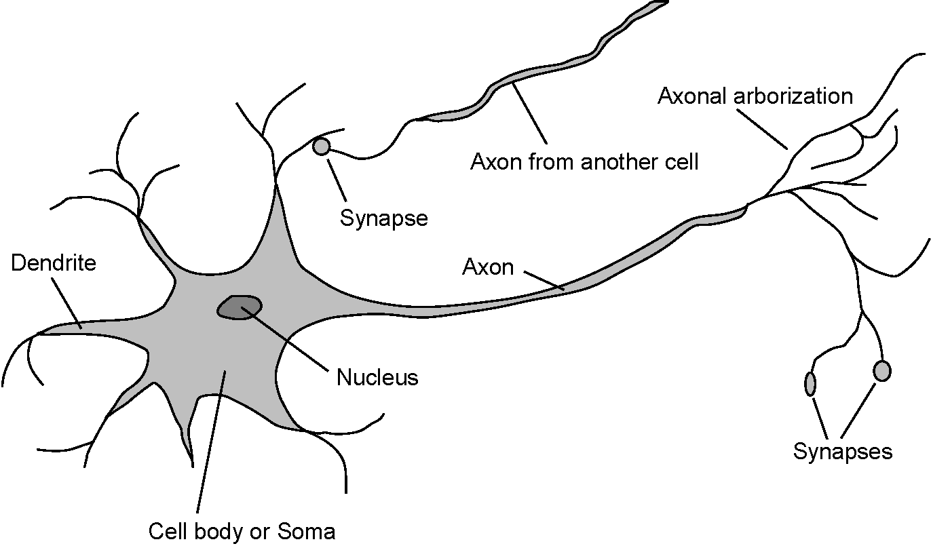
Neural Networks
Neuroscience (1861 – present)
    How do brains process information?
  Study of the nervous system (brain)
  Paul Broca : Speech deficit studies
  Neurons and brain areas
  EEG and fMRI
  Brains cause minds (Searle, 1992)
CS 245 – Robotics and Machine Learning

Slide 3
The Human Brain
The human brain contains about 13 billion nerve cells, or neurons.
  Starts off with closer to 100 billion, many die as we age
  On average, each neuron is connected to other neurons through about 10 000 synapses.
  The brain's network of neurons forms a massively parallel information processing system.
  This contrasts with conventional computers, in which a single processor executes a single series of instructions.
Consider the time taken for each elementary operation
  neurons typically operate at a maximum rate of about 100 Hz
  a conventional CPU carries out several hundred million machine level operations per second.
Despite of being built with very slow hardware, the brain has quite remarkable capabilities:
  its performance tends to degrade gracefully under partial damage. In contrast, most programs and engineered systems are brittle: if you remove some arbitrary parts, very likely the whole will cease to function.
  Plasticity : it can reorganize itself from experience.
    this means that partial recovery from damage is possible if healthy units can learn to take over the functions previously carried out by the damaged areas.
  it performs massively parallel computations extremely efficiently. For example, complex visual perception occurs within less than 100 ms, that is, 10 processing steps!
  it supports our intelligence and self-awareness. (Nobody knows yet how this occurs.)
CS 245 – Robotics and Machine Learning

Slide 4
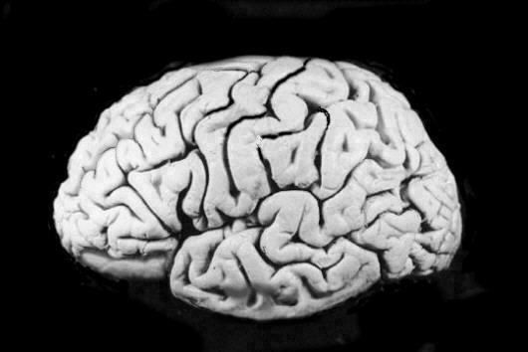

The Human Brain
 | processing elements | element size | energy use | processing speed | style of computation | fault tolerant | learns | intelligent, conscious
 | 10¹⁴ synapses | 10⁻⁶ m | 30 W | 100 Hz | parallel, distributed | yes | yes | usually
 | 10⁸ transistors | 10⁻⁶ m | 30 W (CPU) | 10⁹ Hz | serial, centralized | no | a little | not (yet)
Features of the Brain -
  13 Billion Neurons
  Average several thousand connections each
  Hundreds of operations per second
  Cells die frequently and are never replaced?
  Problems are compensated for by massive parallelism
CS 245 – Robotics and Machine Learning

Slide 5
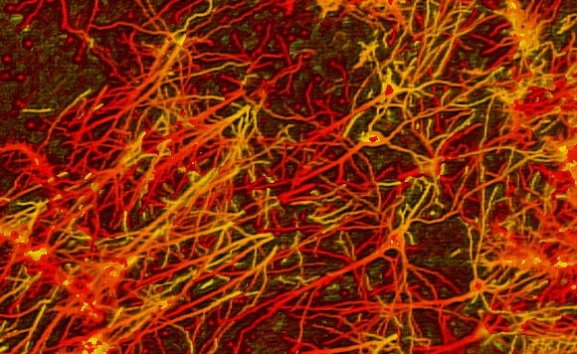
A neuron receives input from other neurons (typically many thousands).
  The inputs are then summed together (approximately).
  Once input exceeds a critical level, the neuron discharges a spike - an electrical pulse that travels from the body, down the axon, to the next neuron(s) (or other receptors).
    This spiking event is also called depolarization, and is followed by a refractory period
    Refractory period is a period after depolarization during which the neuron is unable to fire
The axon endings almost touch the dendrites or cell body of the next neuron
Transmission of an electrical signal from one neuron to the next is effected by neurotransmitters
  Neurotransmitters : chemicals which are released from the first neuron and which bind to receptors in the second.
  This link is called a synapse.
    The extent to which the signal from one neuron is passed on to the next depends on many factors, e.g. the amount of neurotransmitter available, the number and arrangement of receptors, etc.
CS 245 – Robotics and Machine Learning

Slide 6
Learning
Brains learn
  From what we know of neuronal structures, one way brains learn is by
  altering the strengths of connections between neurons, and
  by adding or deleting connections between neurons.
  Furthermore, they learn "on-line", based on experience, and typically without the benefit of a benevolent teacher.
The efficacy of a synapse can change as a result of experience, providing both memory and learning through long-term potentiation.
  One way this happens is through release of more neurotransmitter. Many other changes may also be involved.
CS 245 – Robotics and Machine Learning

Slide 7
Long-term Potentiation
  An enduring (>1 hour) increase in synaptic efficacy that results from high-frequency stimulation of an afferent (input) pathway
Hebbs Postulate:
  "When an axon of cell A... excites cell B and repeatedly or persistently takes part in firing it, some growth process or metabolic change takes place in one or both cells so that A's efficiency as one of the cells firing B is increased."
  Bliss and Lomo discovered LTP in the hippocampus in 1973
Points to note about LTP:
  Synapses become more or less important over time (plasticity)
  LTP is based on experience
  LTP is based only on local information (Hebb's postulate)
CS 245 – Robotics and Machine Learning

Slide 8
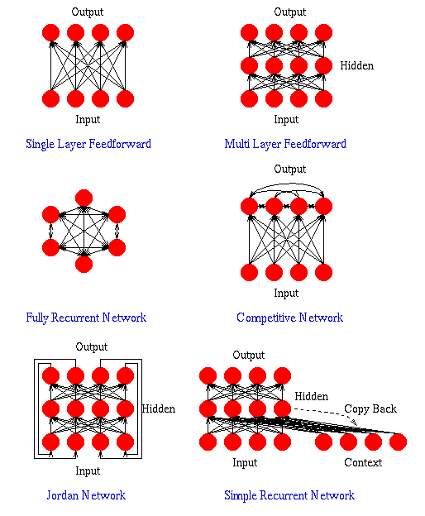
Artificial Neural Networks
An Artificial Neural Network (ANN) is an interconnected assembly of simple processing elements, units or nodes, whose functionality is loosely based on the animal neuron.
The processing ability of the network is stored in the inter-unit connection strengths, or weights, obtained by a process of adaptation to, or learning from, a set of training patterns.
CS 245 – Robotics and Machine Learning

